Slide 1
Types of External Memory
Magnetic Disk
  RAID
  Removable
Optical
  CD-ROM
  CD-Recordable (CD-R)
  CD-R/W
  DVD
Magnetic Tape

Slide 2
Magnetic Disk
A disk is a circular platter constructed of non magnetic material→ substrate
Disk substrate coated with magnetisable material (iron oxide…rust)
Substrate used to be aluminium or aluminium alloy material.
Now glass is used as substrate
Benefits of using glass as substrate
  Improved surface uniformity
    Increases reliability
  Reduction in surface defects
    Reduced read/write errors
  Better stiffness
  Better shock/damage resistance

Slide 3
Read and Write Mechanisms
Recording & retrieval via conductive coil called a head
May be single read/write head or separate ones
During read/write, head is stationary, platter rotates
Write
  Current through coil produces magnetic field
  Pulses sent to head
  Magnetic pattern recorded on surface below
Read (traditional)
  Magnetic field moving relative to coil produces current
  Coil is the same for read and write
Read (contemporary)
  Separate read head, close to write head
  The head consists of partially shielded magneto resistive (MR) sensor
  The MR material has an electrical resistance depends on direction of magnetization medium moving under it
  MR design allows high frequency operation which equates to greater storage density and speed

Slide 4
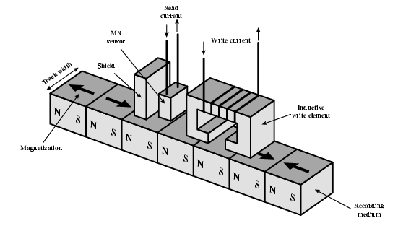
Inductive Write MR Read

Slide 5
Data Organization and Formatting
Concentric rings or tracks
  Gaps between tracks
  Reduce gap to increase capacity
  Same number of bits per track (variable packing density)
  Constant angular velocity
Tracks divided into sectors
Minimum block size is one sector
May have more than one sector per block

Slide 6
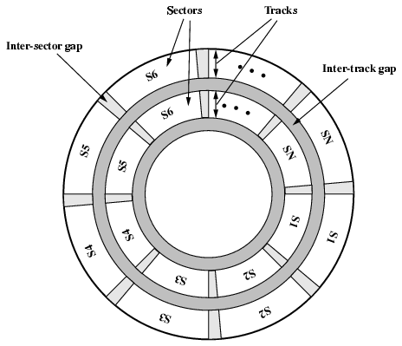
Disk Data Layout

Slide 7
Disk Velocity
Bit near centre of rotating disk passes fixed point slower than bit on outside of disk
Increase spacing between bits in different tracks
Rotate disk at constant angular velocity (CAV)
  Gives pie shaped sectors and concentric tracks
  Individual tracks and sectors addressable
  Move head to given track and wait for given sector
  Waste of space on outer tracks
    Lower data density
Can use zones to increase capacity
  Each zone has fixed bits per track
  More complex circuitry

Slide 8
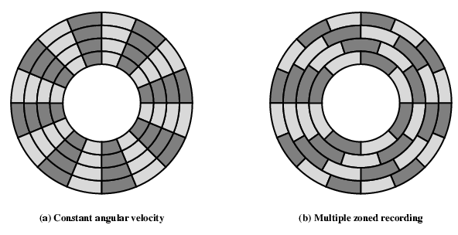
Disk Layout Methods Diagram

Slide 9
Multiple Zone Recording
To increase density, modern hard disk systems use a technique→ Multiple Zone Recording
The surface is divided into number of concentric zone .
Within a zone a number, the number of bit /track is constant.
Zones farther from the centre contain more sectors than zones closer to the centre.
Greater overall storage capacity at the expense of somewhat more complex circuitry.

Slide 10
Finding Sectors
Must be able to identify start of track and sector
Format disk
  Additional information not available to user
  Marks tracks and sectors

Slide 11
Characteristics
Fixed (rare) or movable head
Removable or fixed
Single or double (usually) sided
Single or multiple platter
Head mechanism
  Contact (Floppy)
  Fixed gap
  Flying (Winchester)

Slide 12
Fixed/Movable Head Disk
Fixed head
  One read write head per track
  Heads mounted on fixed ridged arm
Movable head
  One read write head per side
  Mounted on a movable arm

Slide 13
Removable or Not
Removable disk
  Can be removed from drive and replaced with another disk
  Provides unlimited storage capacity
  Easy data transfer between systems
Nonremovable disk
  Permanently mounted in the drive

Slide 14
Multiple Platter
One head per side
Heads are joined and aligned
Aligned tracks on each platter form cylinders
Data is striped by cylinder
  reduces head movement
  Increases speed (transfer rate)

Slide 15
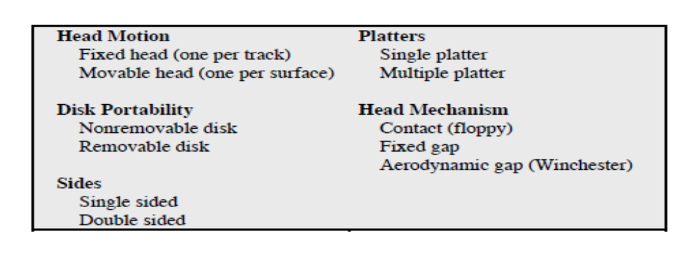
Physical Characteristics of Disk Systems

Slide 16
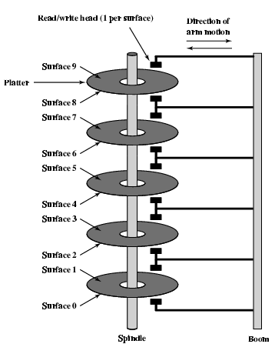
Multiple Platters

Slide 17
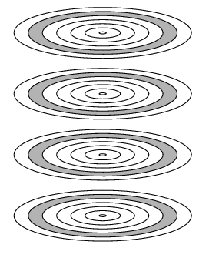
Tracks and Cylinders

Slide 18
Speed Parameters
Seek time
  Time to position head at track
Latency (Rotational)
  Time for head to rotate to beginning of sector
Access time
- Seek time + Latency time
Transfer rate
- The rate at which data can be transferred after access
T = b / N * 1/r
Transfer time = bytes transferred / bytes/track * sec/revolution (track)
Note: How does organization on disk (e.g. random vs sequential) effect total time?

Slide 19
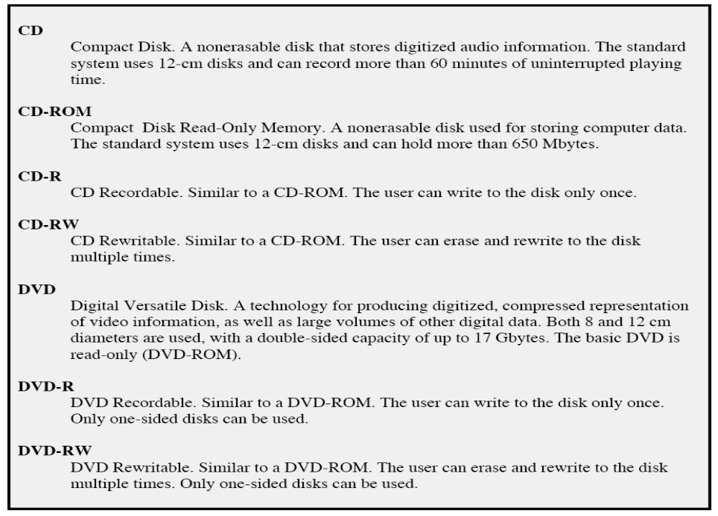
Optical Products

Slide 20
Optical Storage CD-ROM
Originally for audio
650Mbytes giving over 70 minutes audio
Polycarbonate coated with highly reflective coat, usually aluminium
Data stored as pits
Read by reflecting laser
Constant packing density
Constant linear velocity

Slide 21
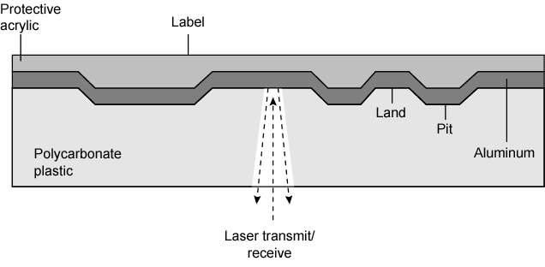
CD Construction

Slide 22
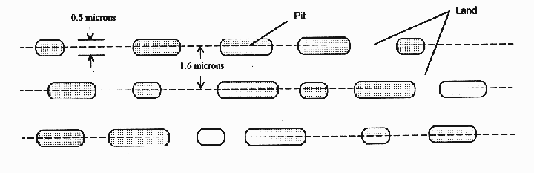
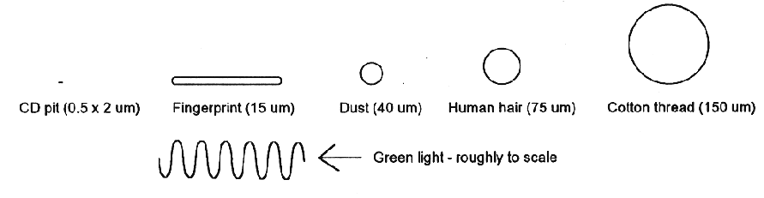
CD Layout

Slide 23
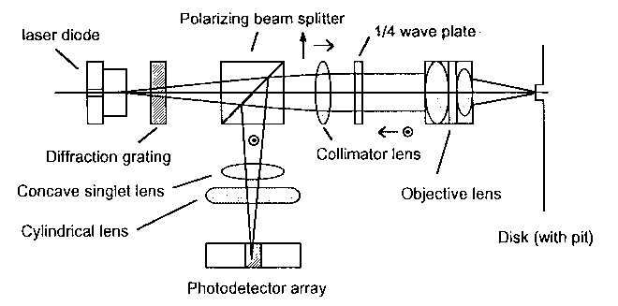
CD reader

Slide 24
CD-ROM Drive Speeds
Audio is single speed
  Constant linear velocity
  1.2 m/sec
  Track (spiral) is 5.27km long
  Gives 4391 seconds = 73.2 minutes
Other speeds are quoted as multiples
  e.g. 24x
  Quoted figure is maximum drive can achieve
Note: CD-ROM has option of error correction (not on CD)

Slide 25
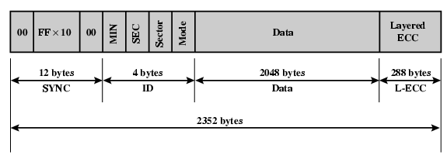
CD-ROM Format
Mode 0 = blank data field
Mode 1 = 2048 byte data + error correction
Mode 2 = 2336 byte data

Slide 26
Random Access on CD-ROM & CD-R
Difficult
Process:
  Move head to rough position
  Set correct speed
  Read address
  Adjust to required location

Slide 27
CD-RW
  Erasable
  Getting cheaper
  Mostly CD-ROM drive compatible
  Phase change
    Material has two different reflectivities in different phase states

Slide 28
DVD - technology
Multi-layer
Very high capacity (4.7G per layer)
Full length movie on single disk
  Using MPEG compression

Slide 29
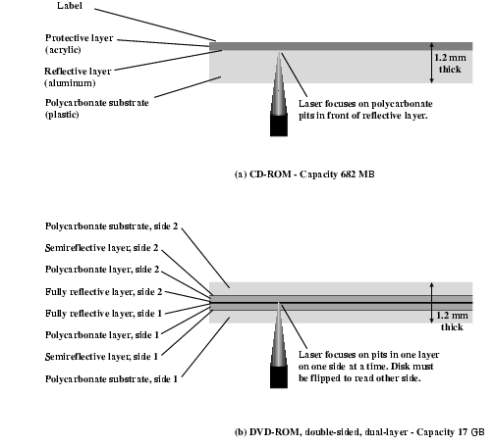
CD vs DVD

Slide 30
DVD’s
Two objectives had to be resolved to make the DVDs viable.
The linear velocity of a DVD must be held constant and be able to reproduce a vertical frame rate of 29.97 frames/second
Every DVD player had to have absolute tracking accuracy to insure the extremely narrow laser beam would scan exactly in the middle of the track where the data was recorded.
The solution:
The disk is pressed with the track grooves accurately pre-cut and encoded with a constant bit rate frequency. Thus a blank DVD disk isn't really blank at all.

Slide 31
Magnetic Tape
Serial access
Slow
Very cheap
Used for backup and archive

Slide 32
References
William Stallings “Computer Organization and architecture”, Prentice Hall, 7th edition, 2006.

